Slide 1
Convolutional Universal Text Information Extractor
ACCENTURE NEW IT
Xiaohui Zhao Ph.D.

Slide 2
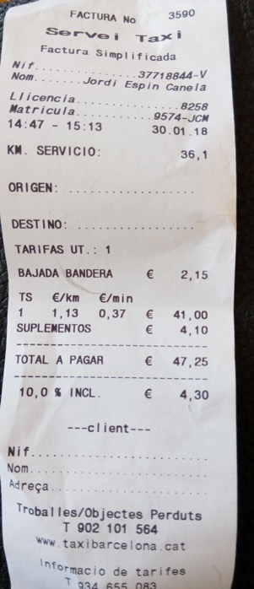
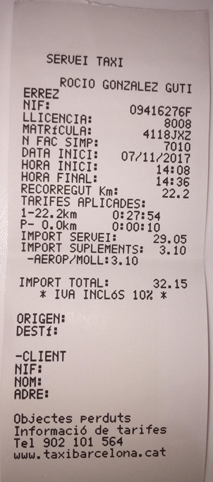
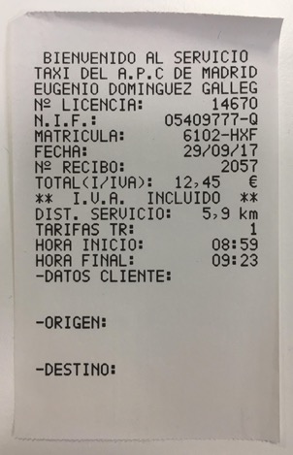
0. Method Brief
Invoices / receipts present with various styles of layouts that were designed for different scenarios or from different entities. Automatically extracting interested words / information from the scanned documents is of great interest to the company’s audit departments. To reduce the labor costs in adapting layouts of various invoices / receipts, a potential effective deep learning based pipeline is proposed.
The pipeline involves but not limited to
exploring words’ semantic information
employing words’ position information
exploring the correlation among interested words / items
involving data augmentation
The interested distance information of different types of invoices appear in various positions with different keyword clues.

Slide 3
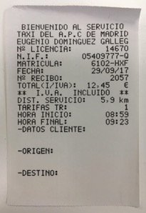
1.0 Model Framework
For each type of invoices / receipts, a standalone AI model is trained to extract different kinds of interested information from the OCR engine processed invoice image.
OCR engine
word positional mapping
 | BIEVENIDO | AL | SERVICIO
TAXI | DEL | A.P.C | DE | MADRID
EUGENIO |  | DOMINGUEZ |  | GALLEG
N° | LICENCIA: |  |  | 14670
...
** | I.V.A. |  | INCLUTIDO | **
DIST. | SERVICIO: |  | 5,9 | km
TARIFAS | TR: |  |  | 1
HORA | INICIO: |  |  | 08:59
HORA | FINAL: |  |  | 09:23
-DATOS | CLIENTE:
…
end-to-end trainable model
for key information extraction
DIST. SERVICIO: 5.9km
key information extraction & reverse word positional mapping
word semantical mapping

Slide 4
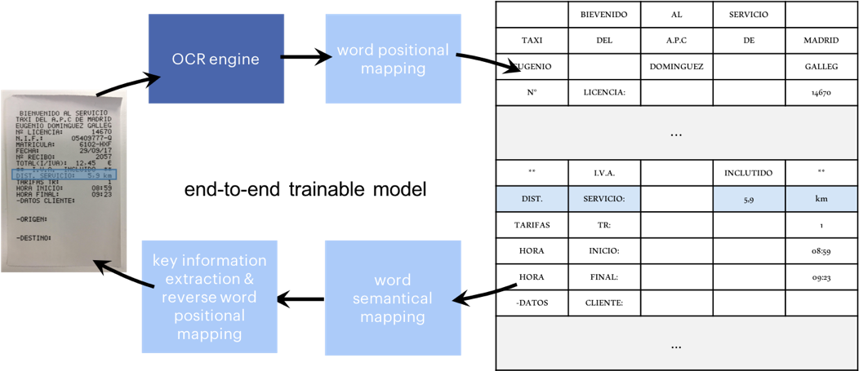
1.1 OCR Engine
An OCR engine is involved in the pipeline as an AI-based sub-system for locating and recognizing texts from given data source, especially for image-based document captured from a scanned document.
An OCR engine outputs texts and their locations.

Slide 5
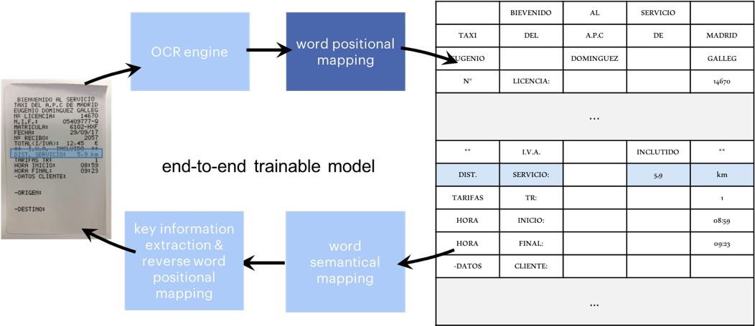
1.2 Word Positional Mapping
For each specific category of invoices / receipts, the recognized words are mapped to a grid table that is designed with different level of granularity in rows or columns.
The granularity parameter is the major reason of building models for a specific categories of invoices / receipts, since a larger row / column granularity indicates a grid table with lesser grids in terms of rows /columns, and a smaller row / column granularity indicates a grid table with more grids in terms of rows / columns.
Pre-processes that can combine words into meaningful entities can be involved in this step, otherwise character-level tokenizers will be used, especially for Chinese documents.
Invoices / receipts with similar number of words distributed horizontally / vertically will benefit from this.
To produce training data (input and output) for training the AI model in the pipeline, the texts that were output from the OCR engine are mapped into a grid table according to their locations.

Slide 6
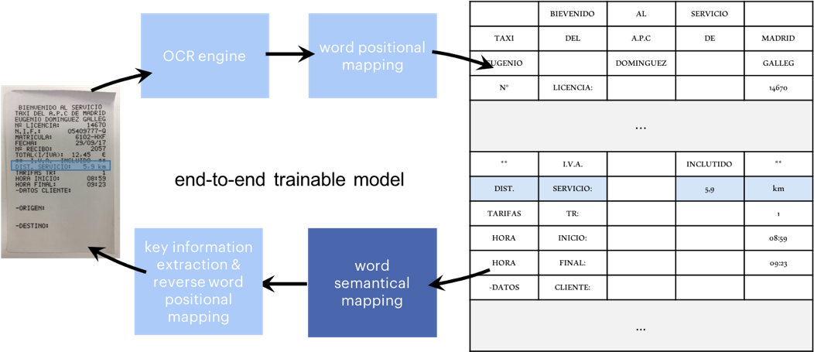
1.3 Word Semantical Mapping
Words have natural correlations to each other, especially in the field of invoices / receipts. For example, one identifies the distance information with keywords of either ‘distance’, ‘DIST.’, or ‘km’. Therefore, mapping words with similar semantic meaning to an embedding space with close distance is beneficial for the subsequent analysis.
The semantically mapping can be achieved either by pretraining an neural embedding layer or manually categorize interested words with similar meaning to the same category. Combining these two methods is also a viable choice.
To further enhance the performance of the pipeline. The extracted words / items can be feed into a trained bi-directional LSTM based slot filling model, where the interested information can be better located and the not interested information can be filtered out.
Semantical information is explored in the pipeline by mapping words into an embedding space.

Slide 7
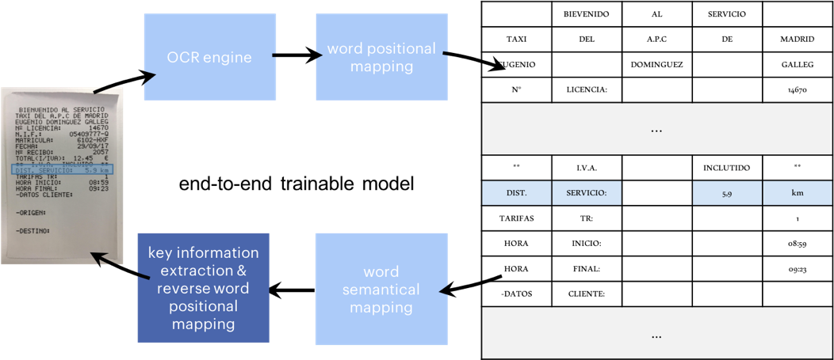
1.4 Key Information Extraction & Reverse Word positional Mapping
Layouts, that is the distribution of interested information, of similar invoices / receipts have minor variation semantically or spatially. Therefore, by exploring the positional information among semantically mapped words, the interested information may be extracted / located in an efficient manner.
The positional information and semantical information are taken into consideration simultaneously by employing the convolutional filters over the grid table. A grid table is generated by the convolutional neural network, where the interested words / items are highlighted by evaluating the values in the table which indicates the possibility of each word belonging to a specific information category, e.g., distance. In future work, RNN based question-answering network can also be added.
Finally, the extracted interested words / items can be reversely mapped to the original image as a visual reference.
Key information is extracted by exploring both the semantic information and the positional information of the words.

Slide 8
2. Data Augmentation & Generation
To decrease the possibility of overfitting and increase the extraction ability of the trained model. Data augmentation can be involved by simply shifting the words / items in the table grids. Furthermore, data generation can also be involved to generated simulation data for scenarios where real data are limited or restricted to be obtained.
 | BIEVENIDO | AL | SERVICIO
TAXI | DEL | A.P.C | DE | MADRID
EUGENIO |  | DOMINGUEZ |  | GALLEG
N° | LICENCIA: |  |  | 14670
...
** | I.V.A. |  | INCLUTIDO | **
DIST. | SERVICIO: |  | 5,9 | km
TARIFAS | TR: |  |  | 1
HORA | INICIO: |  |  | 08:59
HORA | FINAL: |  |  | 09:23
-DATOS | CLIENTE:
…
BIEVENIDO | AL | SERVICIO
TAXI | DEL | A.P.C | DE | MADRID
EUGENIO |  | DOMINGUEZ |  | GALLEG
N° | LICENCIA: |  |  | 14670
...
** | I.V.A. |  | INCLUTIDO | **
DIST. | SERVICIO: |  | 5,9 | km
TARIFAS |  | TR:
HORA |  | INICIO: |  | 1
HORA |  | FINAL: |  | 08:59
-DATOS |  | CLIENTE: |  | 09:23
…

Slide 9
3. Tasks Involved
The involved tasks includes but not limit to
major
converting collected data into proper formats for model training,
implementing word positional mapping,
implementing word semantically mapping,
constructing the model that is based on CNN for key information extraction,
evaluating model performance,
reusing the model based on bi-directional LSTM for slot filling,
minor
implementing and combining data augmentation into the pipeline,
implementing a system for generate training data for the proposed pipeline,
constructing GUI for data labeling

Slide 10
APPENDIX
Layer Name | Filter | Input Size | Output Size
grid_table | identity | original | original
 | 3x5, stride 2

Slide 11
OCR engine
word positional mapping
 | BIEVENIDO | AL | SERVICIO
TAXI | DEL | A.P.C | DE | MADRID
EUGENIO |  | DOMINGUEZ |  | GALLEG
N° | LICENCIA: |  |  | 14670
...
** | I.V.A. |  | INCLUTIDO | **
DIST. | SERVICIO: |  | 5,9 | km
TARIFAS | TR: |  |  | 1
HORA | INICIO: |  |  | 08:59
HORA | FINAL: |  |  | 09:23
-DATOS | CLIENTE:
…
end-to-end trainable model
key information extraction & reverse word positional mapping
word semantical mapping

